Slide 1
UNIT 4

Slide 2
Software configuration management (SCM)
SCM is also known as software control management

Slide 3
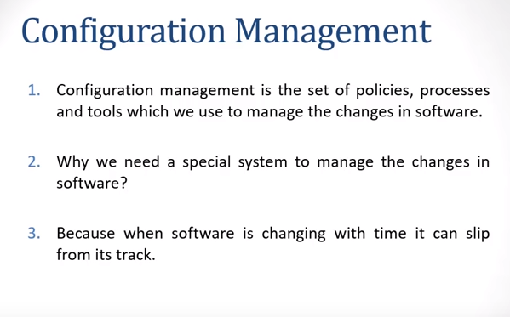


Slide 4
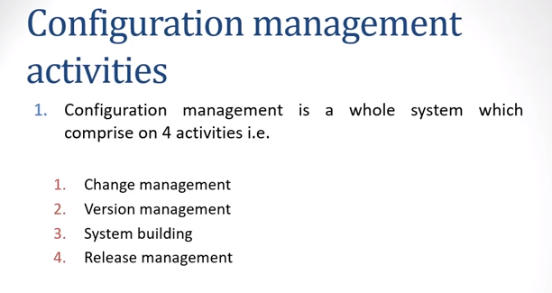

Slide 5
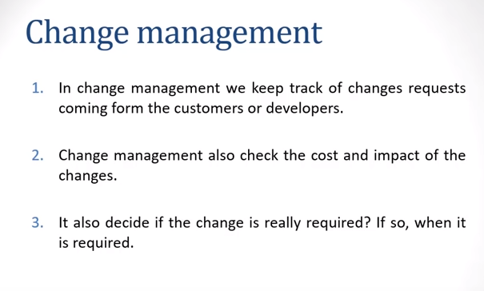

Slide 6
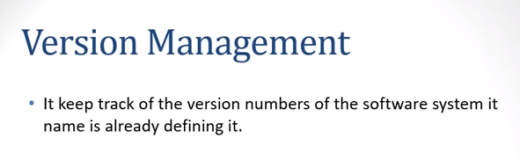

Slide 7
Version Control:-
Software Version Control is a system or tool that captures the changes to a source code elements: files, folders, images or binaries.
A version control system (also known as a Revision Control System) is a repository of files, often the files for the source code of computer programs, with monitored access. Every change made to the source is tracked, along with who made the change, why they made it, and references to problems fixed, or enhancements introduced, by the change.

Slide 8
Risk Mitigation, Monitoring and Management (RMM)

Slide 9
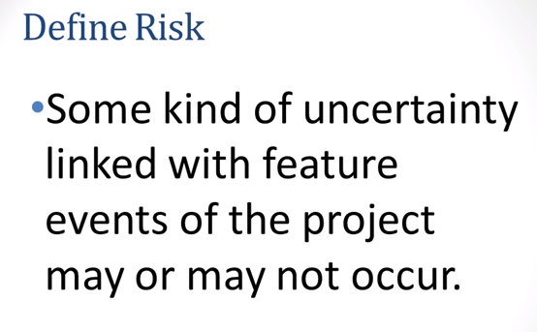
Risks in software projects and its types

Slide 10
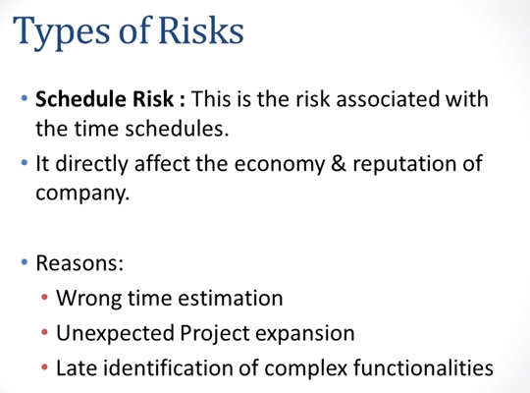

Slide 11
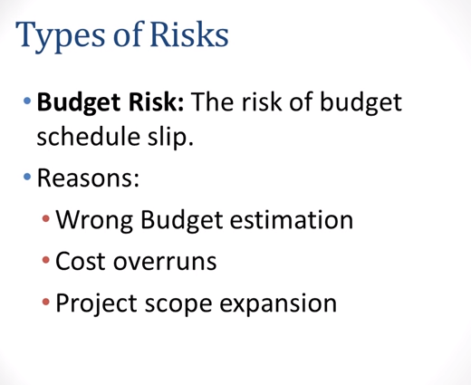

Slide 12
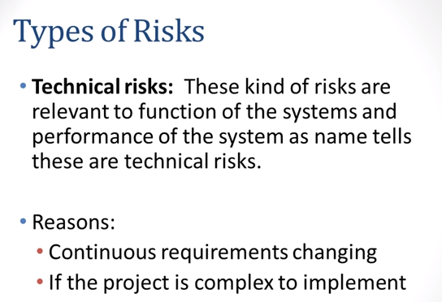

Slide 13
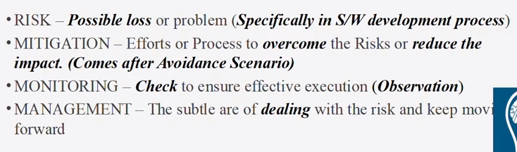
Risk Mitigation, Monitoring and Management (RMM)

Slide 14
contd
1.Mitigation(Prevent)=Proactive Approach
2.Monitoring=Project Manager
3.Management=Reactive Approach
Eg Late Delivery
1.Mitigation(Prevent)=Precautionary measure
2.Monitoring=Scheduling the development
3.Management=Negotiate with customer

Slide 15
Risk Management
Risk management refers to the practice of identifying potential risks in advance, analyzing them and taking precautionary steps to reduce/curb the risk.
Three activities of Risk management
1.Risk Identification
2.Risk assessment
3.Risk containment

Slide 16
Contd…
Risk Identification tells you what the risk is, while
Risk assessment tells you how the risk will affect your objective.
For risk assessment each risk should first be rated in two ways
A) The likelihood of a risk coming true(r).
B)The consequence of the problems associated with that risk(s)
Priority of each risk can be computed as
P=r*s

Slide 17
Risk containment:
There are three main strategies to plan for risk containment:
Avoid the risk- This may take several forms such as discussing with the customer to change the requirements to reduce the scope of the work, giving incentives to the engineers to avoid the risk of manpower turnover, etc.
Transfer the risk- This strategy involves getting the risky component developed by a third party, buying insurance cover, etc

Slide 18
Risk Leverage
Risk Leverage=risk exposure before reduction-risk exposure after reduction
Cost of reduction

